Slide 1

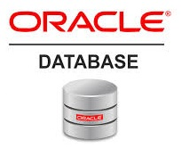
Oracle database
Lecture 4

Slide 2

Today’s Agenda
About Oracle 11g
Downloading Oracle 11g Express Edition
Steps Required During Installation
Setting Up The Password
Testing The Installation

Slide 3
Why Oracle 11 g ?
Since maximum students are beginners in Oracle , so it is recommended to them to start their journey of understanding Oracle basics using Oracle 11g version.
Oracle Database Express 11g is a popular and free SQL database system which can run on common operating systems like LINUX and Windows.
Once we are comfortable with all the basics like USER CREATIION, TABLE CREATION, ACCESSING TABLE DATA etc in Oracle 11g then we can better understand Oracle 19c which is a cloud database

Slide 4
Installing Oracle 11 g
Now , we will learn how to install Oracle 11g on our Window 64-bit PC.
The upcoming slides will guide you through all the installation steps especially when you are a fresher.

Slide 5
Installing Oracle 11 g
Type the following URL or search on Google for Oracle 11g download Release 2
The URL is:
https://www.oracle.com/database/technologies/xe-prior-releases.html

Slide 6
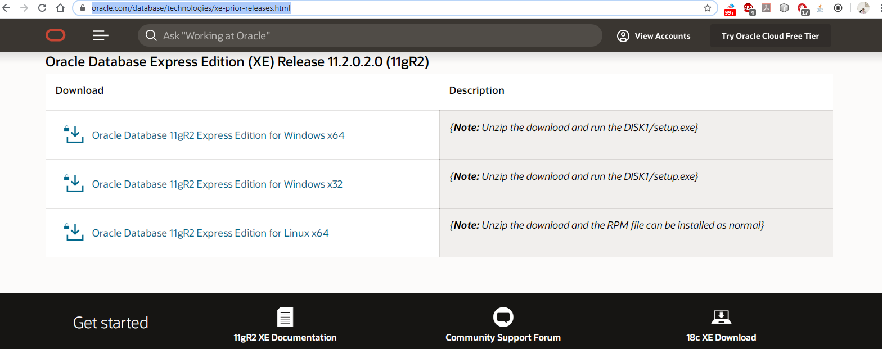
Installing Oracle 11 g

Slide 7
Installing Oracle 11 g
Oracle will ask you to accept license agreement .
Accept it.
Then it will ask you to login .
Type in your username and password
Click on

Slide 8
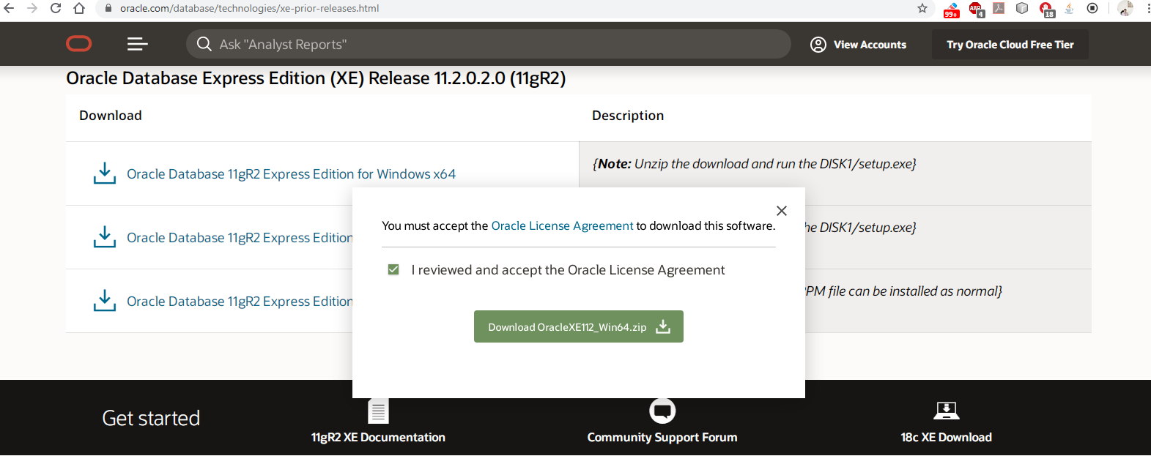
Installing Oracle 11 g

Slide 9
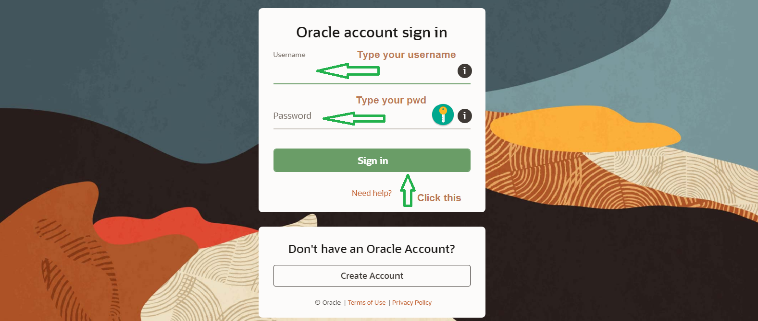
Installing Oracle 11 g

Slide 10
Installing Oracle 11 g
The download will begin .
When the download completes, unzip the downloaded file and you will get a setup.exe file.
Now, right click on setup.exe and "Run as Administrator".
An installer window will pop up.

Slide 11
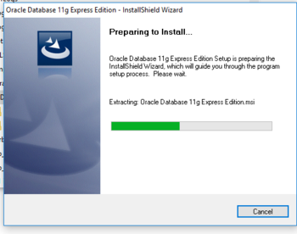
Installing Oracle 11 g

Slide 12
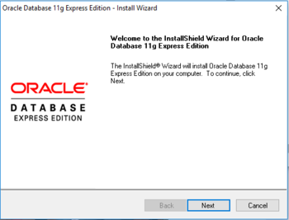
Installing Oracle 11 g
The welcome screen shown in Figure below will be displayed after the installation starts. Just hit the Next button to continue.

Slide 13
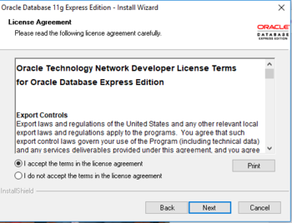
Installing Oracle 11 g
The popup window in Figure below asking for confirmation of license agreement will appear next. You need to accept the license agreement terms and click Next.

Slide 14
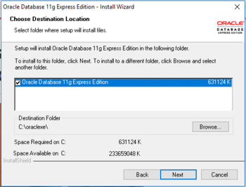
Installing Oracle 11 g
The next popup window in Figure below is to configure the installation directory for the Oracle Express database. Continue with the default settings.

Slide 15
Installing Oracle 11 g
Next, a popup window, shown in Figure below, will appear asking for the password for the administrator accounts (both the SYS and SYSDBA database accounts).
Setup a suitable password and ensure that you remember it for future use.

Slide 16
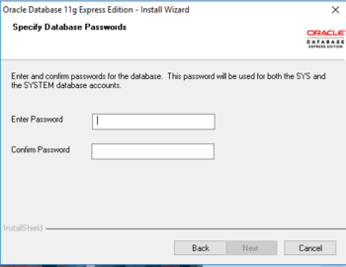
Installing Oracle 11 g
Most important step . Do remember the password you set here.

Slide 17
Installing Oracle 11 g
The final window appearing before the actual installation process starts.
Please check to ensure that all settings are correct. If everything is already configured correctly, hit the Install button to start the installation process.
The installation process will probably take between 10 to 15 minutes to complete.

Slide 18
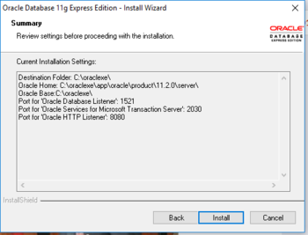
Installing Oracle 11 g

Slide 19
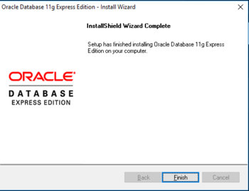
Installing Oracle 11 g
The popup window shown in Figure below will appear once the installation is complete. Click the Finish button to complete the installation process.

Slide 20
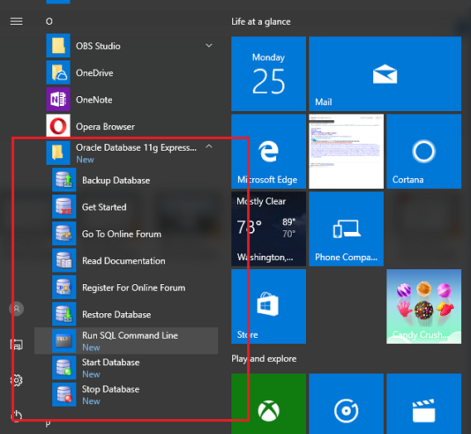
Installing Oracle 11 g
Go to the Windows Start menu and look for 'Oracle Database 11g Express':

Slide 21
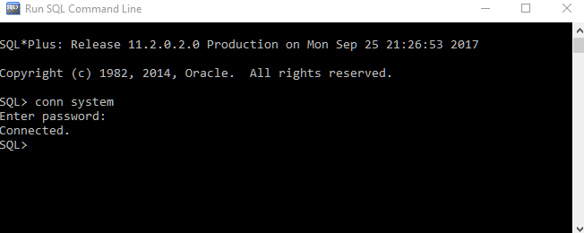
Installing Oracle 11 g
From 'start menu' click on 'Run SQL Command Line' and use 'conn' command to connect the database. We are going to connect as user 'system' (enter the same password you chose during the installation process):

